Slide 1


NHL game Analytics
Transforming Raw Hockey Data into Performance Intelligence
Team : Benjamin, Michelle, Marcus
Notes:
Introduce the project, team members, and overall goal.
Presenter 1
Time : 10 sec
“Good [morning/afternoon], everyone. We’re Team BMM, and today we’ll be presenting our project on NHL Game Analytics — where we transform raw hockey data into performance intelligence. I’m Marcus, and together with Benjamin and Michelle, we’ll walk you through how we built this end-to-end analytics solution.”

Slide 2

Project Premise
Why NHL Data?
NHL organisers have collected information on NHL matches over 20 years and would like to have a better insight of the data
Notes:
Explain the motivation and business value.
Presenter 1
Time: 30 secs
“This project leverages over 20 years of NHL match data to turn historical game records into decision-support insights. The value of this project isn’t just about hockey, it’s about showing how raw historical data can be transformed into meaningful insights
By organizing and modeling this data properly, we can identify performance trends, compare players and teams objectively, and understand how the league evolves over time. From a business standpoint, this is similar to how organizations use data to guide decisions — whether it’s performance benchmarking, strategy planning, or reporting. So this project demonstrates how good data structure turns information into something you can actually use to make decisions.”

Slide 3

Objectives
Design and implement a scalable ELT data pipeline
Develop an analytics-ready dimensional data model
Deliver an interactive Power BI dashboard for insights
Notes:
Walk through technical and business objectives.
Presenter 1
Time: 25 sec
The objectives of this project were threefold. First, we aimed to design and implement a scalable ELT pipeline that could reliably ingest and transform raw NHL data. Second, we focused on developing an analytics-ready dimensional data model to support efficient querying and accurate analysis. Finally, we delivered an interactive Power BI dashboard to translate the data into meaningful insights for end users.

Slide 4
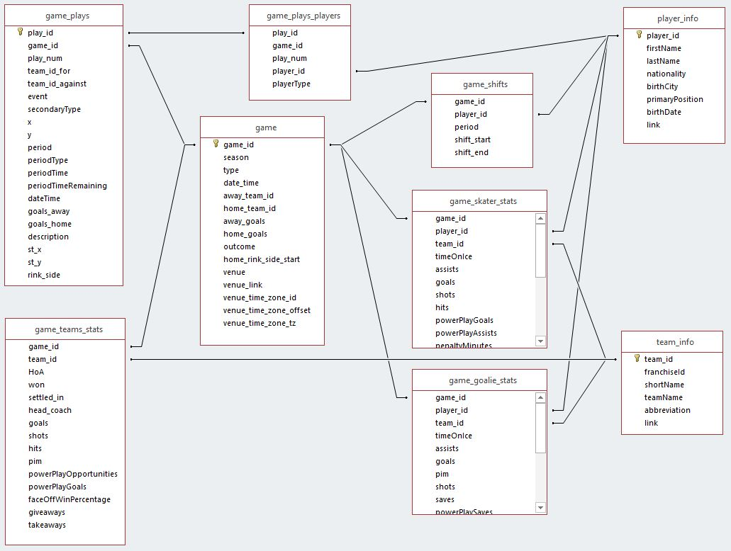
Dataset Overview
Kaggle URL : https://www.kaggle.com/datasets/martinellis/nhl-game-data
20 years of NHL Data
12 comma separated value data files
Notes:
Describe dataset scope and challenges.
Presenter 1
Time: 30 secs
This dataset brings together detailed NHL game, player, and team data spread across 12 raw CSV files. It captures game events, player performance, and team interactions at a granular level, which allows us to analyze trends, efficiency, and performance patterns.
The challenge is that the data is not analytics-ready. Because it comes from multiple raw sources, we face inconsistent identifiers, missing values, schema mismatches, and broken relationships between entities. There’s also no predefined analytical structure, so we must clean, standardize, and model the data before it can support reliable insights.

Slide 5

Technology Stack
Microsoft Fabric
Lakehouse (Delta Tables)
PySpark
Data Pipeline
Power BI
Notes:
Presenter 1
Time: 50 secs
For this project we used Microsoft Fabric as our end-to-end analytics platform. The reason is simple —
it brings data engineering, storage, and BI into one environment, which makes the whole pipeline easier to manage.
We implemented a Lakehouse using Delta tables, so we get the flexibility of a data lake but with warehouse-level reliability like schema control and versioning.
PySpark handles our data transformations — especially useful for cleaning and structuring large datasets efficiently.
Fabric pipelines orchestrate the movement of data across Bronze, Silver, and Gold layers, ensuring automation and consistency.
Finally, Power BI connects directly to the curated model so stakeholders can explore insights through interactive dashboards.”

Slide 6
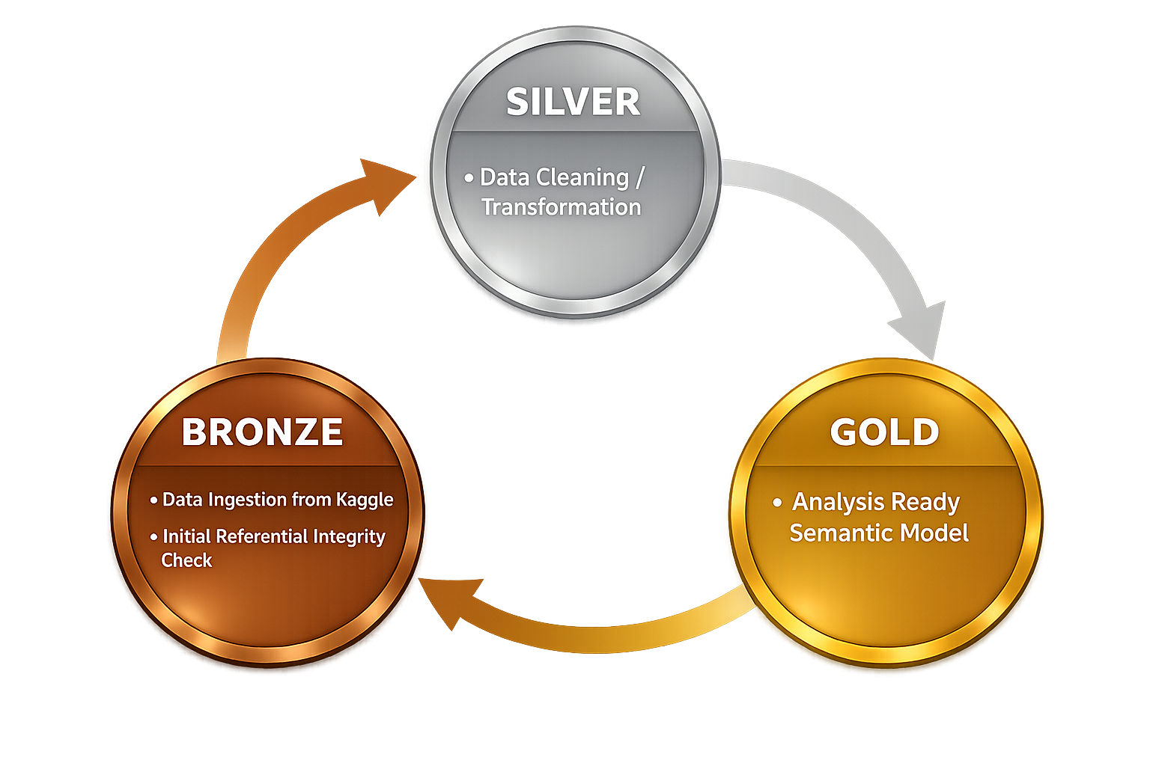
Architecture Overview
Architecture will follow a medallion structure
Notes:
Explain layered architecture and rationale.
Presenter 2
Time: 1 min
This slide shows our medallion architecture, which organizes the pipeline into Bronze, Silver, and Gold layers, each with a clear purpose.
The Bronze layer is where raw data lands. We keep it as close to the source as possible so we preserve traceability.
The Silver layer is where most of the transformation happens — cleaning, standardizing, and enforcing data integrity so the data becomes reliable and structured.
The Gold layer is the analytics layer. Here we model the data into fact and dimension structures and build the semantic model used by Power BI.
This layered design helps us improve data quality step by step, prevents errors from flowing downstream, and makes the system easier to maintain.
It also allows us to iterate — if we discover issues during analysis, we can refine the earlier layers without breaking the whole pipeline.”

Slide 7
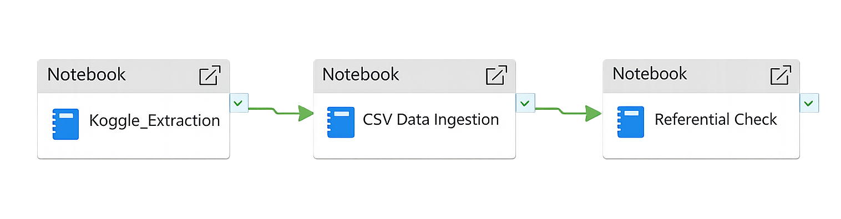
Bronze Layer
Ingest raw source data without transformation
Apply minimal processing to maintain data fidelity
Perform initial referential integrity checks on key identifiers
Notes:
Discuss raw data handling.
Presenter 2
Time: 50 secs
The Bronze layer represents the entry point of data into the platform and is designed to closely mirror the source systems.
At this stage, data is ingested in its raw form directly from Kaggle without applying business logic or complex transformations. This ensures that the original data is always preserved and can be reprocessed if requirements change.
Processing in the Bronze layer is intentionally kept minimal. We focus on basic schema alignment and metadata capture while avoiding data cleansing or enrichment, which are deferred to later layers.
The only validation applied at this stage is a simple referential integrity check on key identifiers, such as game IDs, team IDs, and player IDs. This allows us to identify missing or inconsistent keys early, while deferring corrective actions to the Silver layer where proper transformations and remediation can be applied.
This approach improves pipeline reliability and supports an iterative development process.

Slide 8
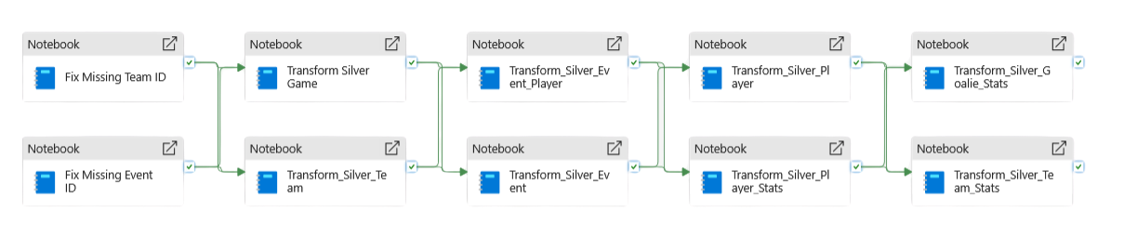
Silver Layer
Cleanse and standardize datasets for analytical consistency
Remove duplicate and redundant records
Normalize attributes to appropriate analytical granularity
Apply data formatting and enrichment rules
Consolidate tables to support downstream analytics
Notes:
Detail transformations and data quality.
Presenter 2
Time: 1.15 min The Silver layer is where the raw data is transformed into a clean, consistent, and analysis-ready structure. At this stage, we perform data cleansing and standardization, including handling null values, correcting data types, and aligning naming conventions across tables.
Duplicate records are identified and removed to ensure that each business entity — such as games, teams, or events — is represented only once. This improves data quality and prevents aggregation errors in downstream analysis.
As part of the Silver layer processing, data-fix notebooks were introduced to append missing key identifiers, such as team and event IDs. These fixes serve as temporary remediation steps to maintain referential integrity and enable downstream transformations, while clearly highlighting data quality issues that should be addressed at the source in collaboration with data owners.
From a pipeline orchestration perspective, the Silver layer was initially designed to execute the fix notebooks in parallel, followed by multiple transformation notebooks running in parallel once the fixes were completed. This approach reflects a scalable, production-style dependency model. However, due to compute limitations in the trial Spark environment, the pipeline was adapted to execute in a serial sequence. Despite this constraint, the logical dependency structure and data integrity guarantees were preserved.
Overall, the Silver layer acts as the foundation for a reliable and scalable semantic model in the Gold layer.

Slide 9
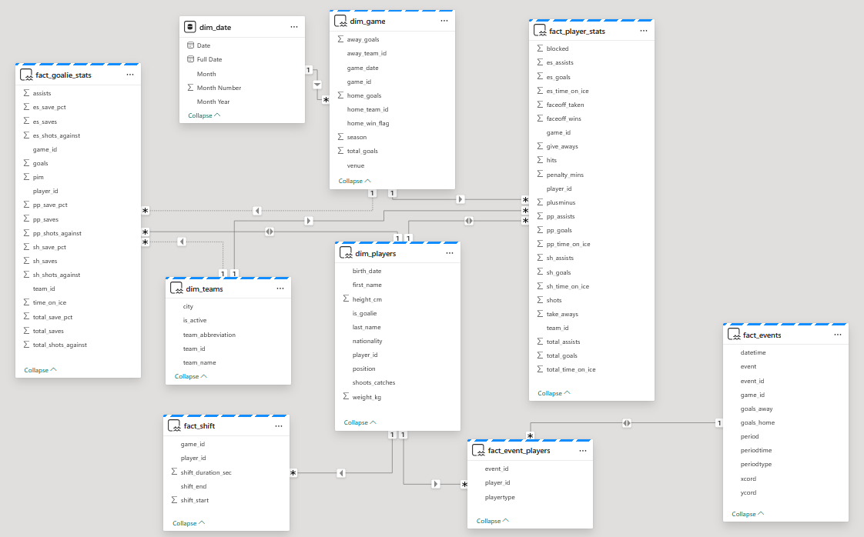
Initial Data Model
Early Semantic Model
Central fact tables link event player, goalie stat., shift and event data
Dimension tables provide contextual attributes for teams, game, players, and dates
Relationships enable analytics across performance, shifts, and in-game events
Notes:
Explain why initial model was insufficient.
Presenter 2
Time: 35 secs
This was our initial data model, created early in the project when our domain knowledge was still developing. It closely followed the source data structure and helped us explore the dataset, but later analysis highlighted opportunities to improve relationships and grain, which led to the refined model shown next.

Slide 10
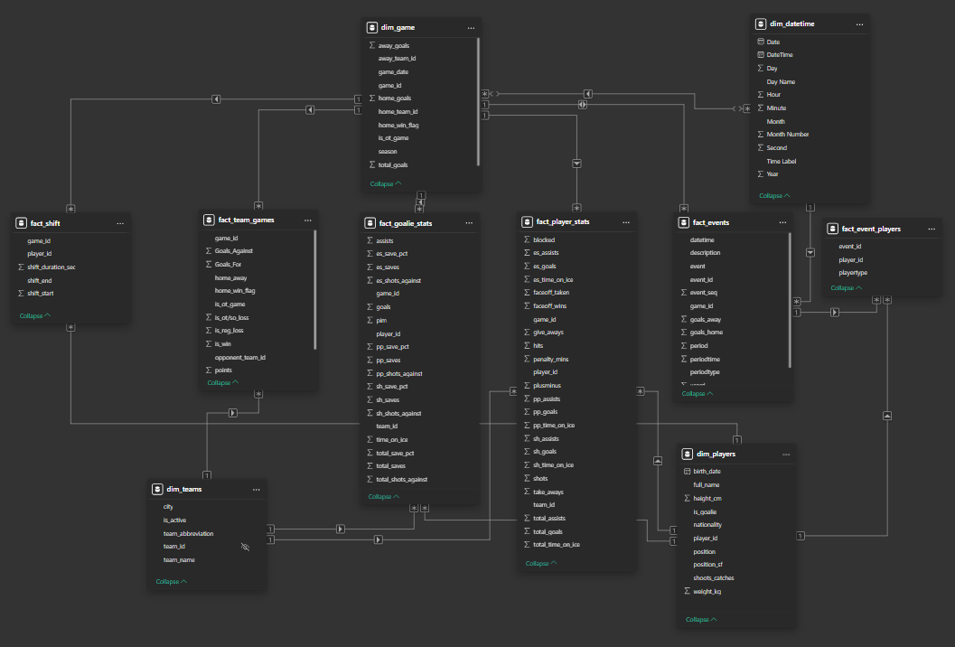
Final ERD
Fact and dimension models finalized for efficient reporting
Data structures optimized to support analytics performance
Insights documented to guide future Silver-layer improvements
Notes:
Explain improvements and benefits.
Presenter 2
Time: 1.15 min
This slide shows the final Entity Relationship Diagram, which represents the semantic model used for analytics and reporting.
Structurally, this is a fact constellation (or galaxy) schema — meaning we have multiple fact tables connected to a smaller set of shared dimension tables. This design fits the NHL dataset because it contains multiple business processes at different grains. For example, play-by-play events occur at an event level, while player and goalie statistics are typically summarized at the game level, and shift data captures time-on-ice intervals. Modeling these as separate fact tables helps preserve the correct grain for each process while still enabling cross-analysis through common dimensions like game, player, team, and date-time.
During the visualization stage in Power BI, we identified additional structural refinements that would further improve analytical flexibility and relationship modeling. These were not implemented in the original Silver transformations but are captured here in the final ERD to guide future iterations.
The first refinement is addressing reduced granularity in the source data — for example, home and away team identifiers originally stored within a single record. Normalizing these so each team can be represented more flexibly improves relationship design and downstream analysis.
The second refinement is improving attribute placement for analytics. Certain fields are more useful when consolidated into the most relevant fact table — for instance, ensuring overtime and shootout indicators sit cleanly within the fact_game table to simplify reporting logic and improve performance.
Overall, this final ERD reflects both our refined domain understanding and the iterative feedback loop between modeling and visualization, forming a scalable foundation for the Gold-layer semantic model.

Slide 11
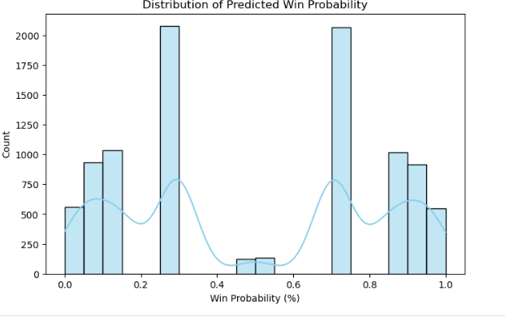
Machine learning p.o.c.
Probabilities cluster near 0 or 1, not normal distribution.
Spread shows model confidently differentiates winners and losers.
Large input scale caused earlier low-probability predictions
Notes:
Machine Learning POC
We transform game data, engineer features, train a logistic regression model, and predict each team’s win probabilities.

Slide 12

Power BI Strategy
Design Principles
Minimal clutter
Consistent filters and slicers
Target Users
Coaches
Analysts
Operations & strategy teams
Notes:
Design principles and audience.
Presenter 3
Time: 30 secs
For the Power BI dashboards, we focused on keeping the design simple and intentional. Visuals were kept uncluttered so users could quickly interpret trends without unnecessary noise.
We also ensured consistent filters and slicers across pages, allowing users to move between views without reorienting themselves.
The dashboards were designed with multiple audiences in mind — including coaches, analysts, and operations or strategy teams — balancing high-level insights with the ability to explore details when needed.

Slide 13
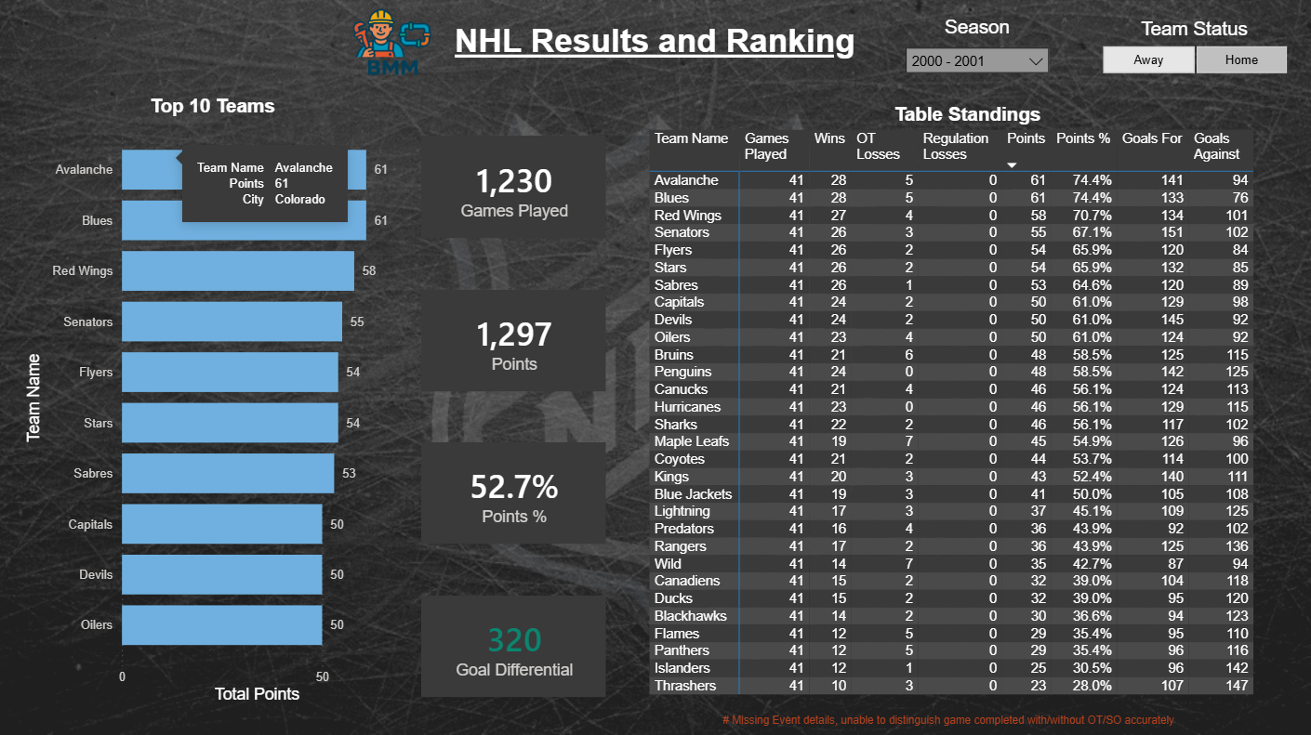
DASHBOARD: Overview
League standings based on official NHL points rules
2 points awarded for regulation wins, 1 point for OT/SO losses
Performance metrics normalized per 60 mins of TOI
Notes:
Explain high-level KPIs.
Presenter 3
Time: 45 sec
This page provides a league-level overview of NHL performance metrics for the selected season.
Team rankings and standings are based on the standard NHL points system, where teams earn two points for a regulation win and one point for an overtime or shootout loss. This ensures the standings align with real-world league rules.
To allow for fair comparison across teams and games, all key performance calculations are normalized on a per-60-minutes time-on-ice basis. This removes bias caused by differences in game length, overtime, or player usage.
Together, this allows the dashboard to present a consistent, comparable view of league performance while still reflecting official NHL scoring logic.

Slide 14
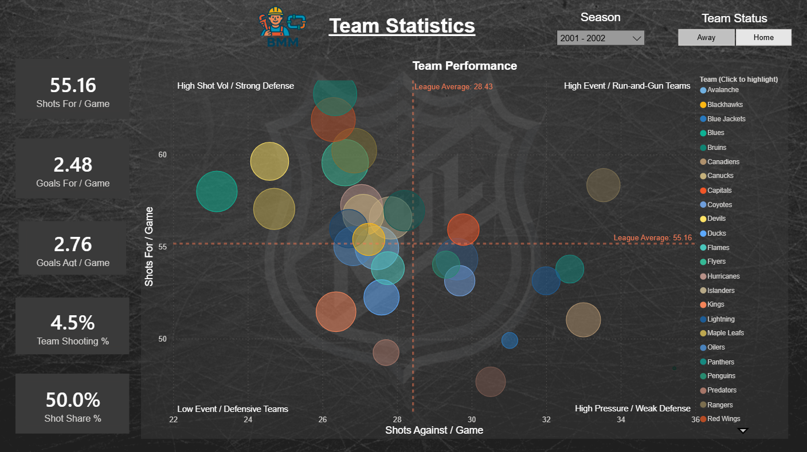
Dashboard: Team STATS
Team-level performance metrics
Comparison of offensive output versus defensive pressure
League averages used as reference benchmarks
Notes:
Team-level insights.
Presenter 3
Time: 45 sec
This page focuses on team-level performance, comparing offensive production against defensive pressure across the league.
The scatter plot visualizes teams based on shots for per game versus shots against per game, with league averages shown as reference lines. This allows teams to be grouped into general play-style profiles, such as high-event, defensive, or run-and-gun teams.
Supporting KPIs on the left summarize key metrics such as shots for, goals for, goals against, shooting percentage, and shot share, all calculated on a per-game basis.
By normalizing the metrics and using league averages as benchmarks, this view makes it easier to identify teams that outperform expectations offensively, apply strong defensive pressure, or exhibit balanced play.

Slide 15
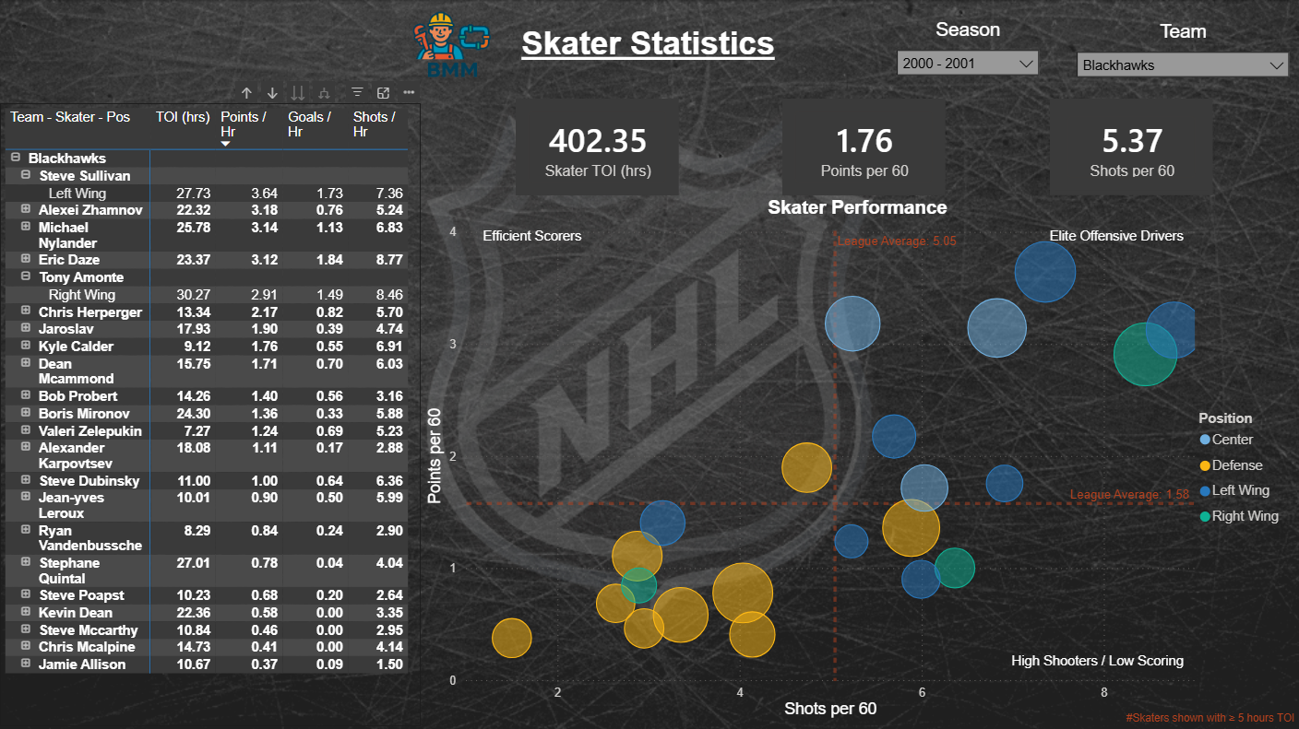
Dashboard: Skater STATs
Player performance normalized per 60 mins of time on ice
Comparison of scoring efficiency versus shot volume
League averages used to identify performance profiles
Notes:
Explain temporal patterns.
Presenter 3
Time: 45 sec
This page shifts the analysis from team-level performance to individual skater performance.
All metrics on this page are normalized per 60 minutes of time on ice, which allows fair comparison between players regardless of role, ice time, or line assignment.
The scatter plot compares shots per 60 versus points per 60, with league averages shown as reference lines. This helps distinguish different player profiles, such as efficient scorers, high-volume shooters, and players who generate shots but convert less frequently.
The table on the left provides supporting detail, including total ice time and rate-based metrics, and allows users to drill into specific teams or positions using the slicers.
Overall, this view helps identify players who drive offensive value efficiently, rather than simply those who accumulate raw totals due to higher ice time.

Slide 16
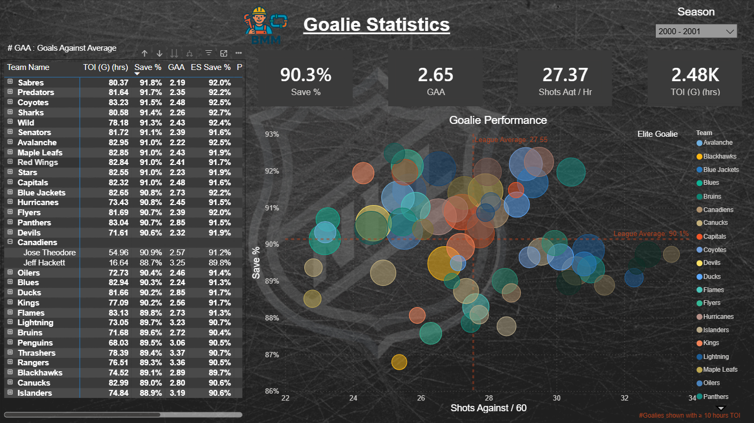
Dashboard: Goalie Stats
Goalie performance normalized per 60 mins of ice time
Comparison of save efficiency versus defensive workload
League averages used to identify goalie performance profiles
Notes:
Explain temporal patterns.
Presenter 3
Time: 45 sec
This page focuses on goalie performance, analyzed using rate-based metrics to allow fair comparison across teams and game situations.
All statistics are normalized per 60 minutes of time on ice, which helps account for differences in defensive systems, game pace, and total shots faced.
The scatter plot compares shots against per 60 with save percentage, using league averages as reference lines. This allows us to distinguish goalies facing high defensive pressure from those operating behind stronger defensive teams.
Supporting KPIs highlight key indicators such as save percentage, goals against average, shots faced per hour, and total ice time.
Together, this view helps identify goalies who perform efficiently under pressure versus those whose strong metrics may be influenced by lower shot volumes.

Slide 17
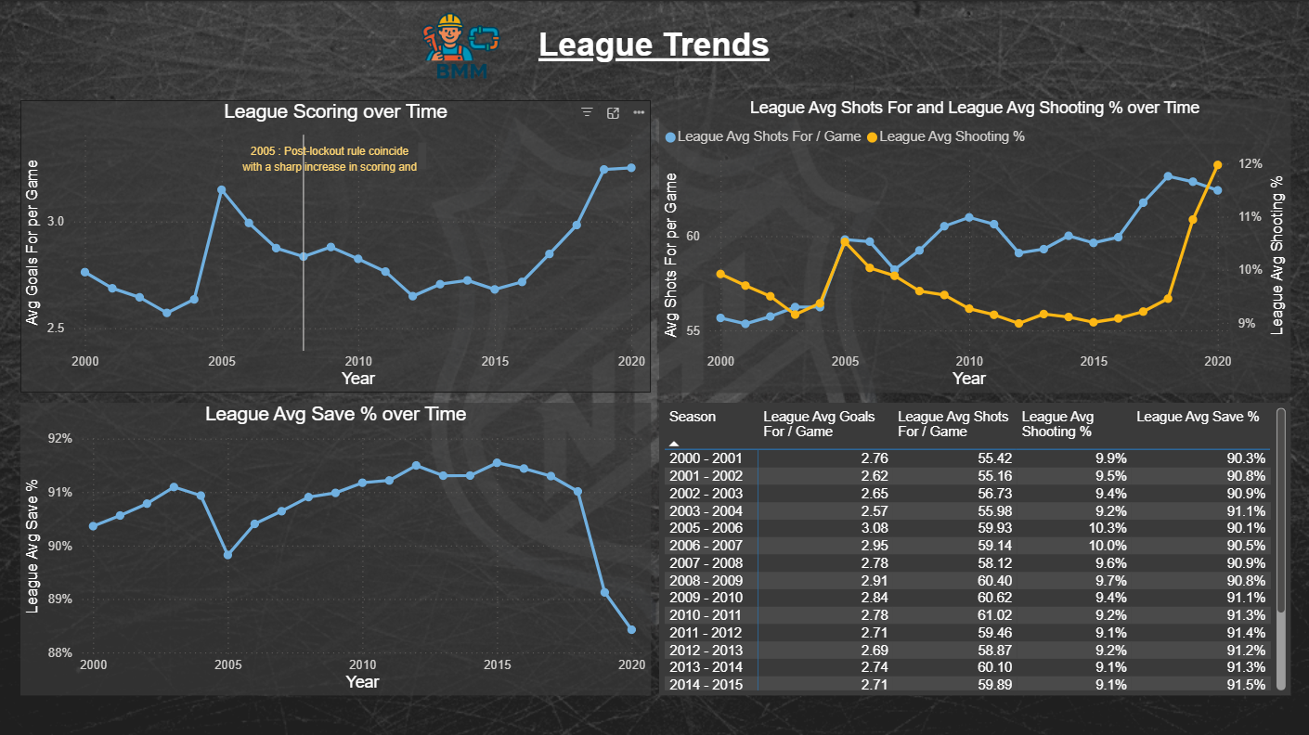
Dashboard: League Trend
League wide scoring, shot volume and efficiency trends over time
Normalized season-level metrics for consistent comparison
Highlights structural changes in league play style
Notes:
Explain big picture trends
Presenter 3
Time: 45 sec
This page looks at league-wide trends over time, helping us understand how the NHL’s style of play has evolved across seasons.
The visuals track average goals per game, shots per game, shooting percentage, and save percentage, all calculated at the league level to provide a consistent macro view.
One notable inflection point occurs around the 2005 post-lockout period, which coincides with a sharp increase in scoring. This aligns with known rule changes that encouraged faster play and reduced defensive obstruction.
Over time, we can also observe that increases in scoring are not driven solely by shot volume. Changes in shooting efficiency and save percentage play a significant role, reflecting tactical evolution, player skill development, and goaltending trends.
Overall, this view provides important context for interpreting team and player performance, ensuring that individual seasons are evaluated within the broader evolution of the league.

Slide 18

Challenges
Initial learning curve due to limited domain knowledge
Incomplete and missing source data (team identifiers, event details)
Schema rigidity once the semantic model was established
Iterative rework required when analytical gaps were identified
Compute and resource limitations in the trial environment
Notes:
Discuss challenges and validation.
Presenter 3
Time: 55 sec
Throughout the project, we encountered several challenges that influenced both our design decisions and iteration process.
One early challenge was limited domain knowledge, particularly around NHL gameplay structure and event-level data. This impacted our initial modeling decisions and required refinement as our understanding improved.
We also faced missing and incomplete data, including gaps in team identifiers and event details. These issues required temporary remediation and highlighted the need for clearer data ownership at the source. “Dimensional Modeling” tighten process.
Another key challenge was that once the semantic model was established, making structural changes was no longer trivial. Significant schema changes would have required reworking earlier transformation stages, reinforcing the importance of careful upfront modeling.
Finally, compute limitations in the trial environment constrained parallel execution, requiring some pipelines to be run serially instead.
These challenges ultimately reinforced the importance of iterative development, strong data modeling foundations, and close alignment between analytics and engineering decisions.

Slide 19

KEY learnings & Improvements
Improve logging and monitoring of data transformation activities
Incorporate visualization stage transformations back into the silver layer
Extend analysis to other data which is also available
Leverage shot coordinate data for spatial analysis
Explore player shift data for workload and usage patterns
Analyse home versus away performance effects
Notes:
Summarize insights and business value.
Presenter 3
Time: 55 sec
Based on the challenges encountered, several key lessons and opportunities for improvement were identified.
One important learning was the need for stronger logging and monitoring of transformation activities, which would improve traceability, debugging, and validation across pipeline runs.
During dashboard development, some transformations were applied at the visualization layer to support analysis. In future iterations, these would be incorporated back into the Silver layer to maintain a cleaner separation between data preparation and consumption.
The dataset also contains additional information that was not fully explored within the project timeframe. For example, shot coordinate data could be used for spatial and shot quality analysis, while player shift data could provide deeper insight into workload, fatigue, and deployment strategies.
Finally, further analysis of home versus away performance could uncover situational advantages and contextual trends at both the team and player levels.
These enhancements reflect the iterative nature of the data engineering process and demonstrate how analytical insights can continuously inform upstream pipeline improvements.

Slide 20

THANK YOU!
Questions and Answers

